Slide 1
Time Series Databases
ALL YOU NEED TO KNOW ABOUT

Slide 2

Agenda
Time Series
What is a Time Series?
Components of a Time Series
Time Series Data Model
Time Series Databases
TSDB Properties
TSDB Benefits
TSDB Real World Application
TSDB Use Cases
Real World Case Studies
Popular TSDB
Influx Demonstration
Why InfluxDB?
Installation and Data Import
Using InfluxDB

Slide 3
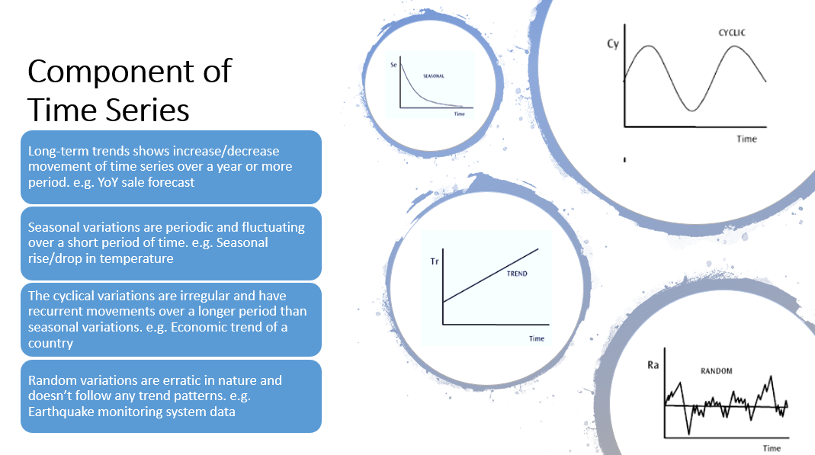
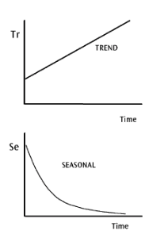
Components of Time Series
Trends
Long-term Trends
Short-term Trends
The increase or decrease in the movements of a time series is called trend.
Long-term trends are generally considered over a year or more period.
Ex. The sales increase/decrease over a period of time
Seasonal variations which occurs periodically and fluctuates over shore span in a time series.
Ex. Temperature rise during summer and drop in winter

Slide 4
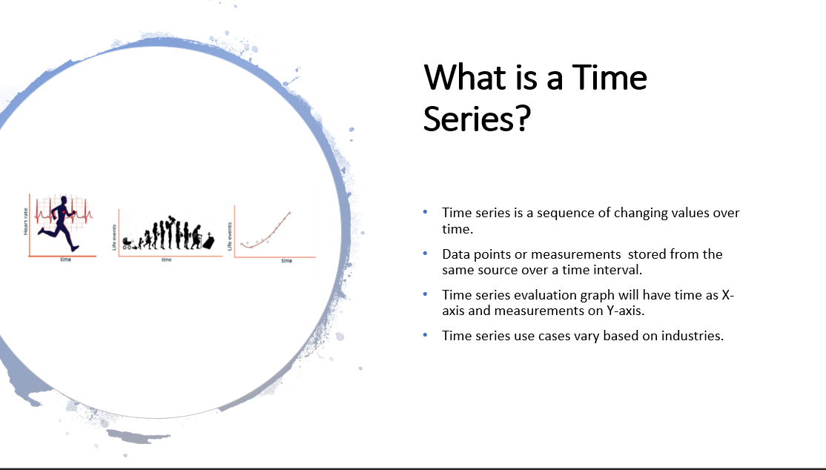

Slide 5
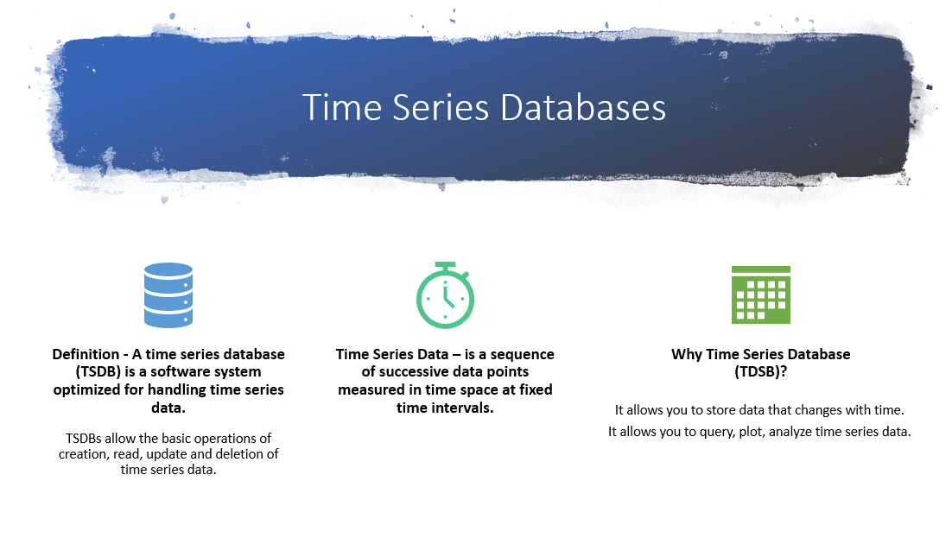

Slide 6
TDSBs Properties
Data Storage
TDSB helps solve the shortcomings and drawbacks of the RDBMS in terms of time series data storage.
Size -
A single IoT sensor with a 1 second monitoring interval will generate 86,400 data points every day.
10x sensors and 60x samples per hour can easily turn storage size from TB to PB very quickly.
Separation –
Time series data has very typical characteristics of being hot or cold.
Where older (cold) the data that is less likely it is to be queried or analyzed frequently.
The real time query features of TDSB helps analyzing hot data efficiently.
timestamp | cluster | host name | Temp. | Pres.
2019-04-28T17:50:00z | cluster-A | host-a | 85 | 40
timestamp | cluster | host name | Temp. | Pres.
2019-01-28T17:50:00z | cluster-A | host-a | 85 | 40

Slide 7
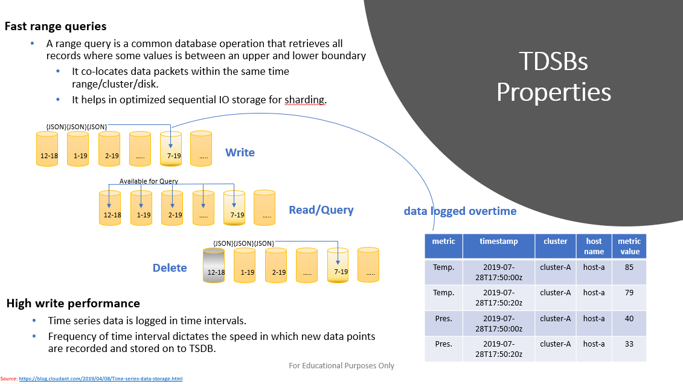

Slide 8
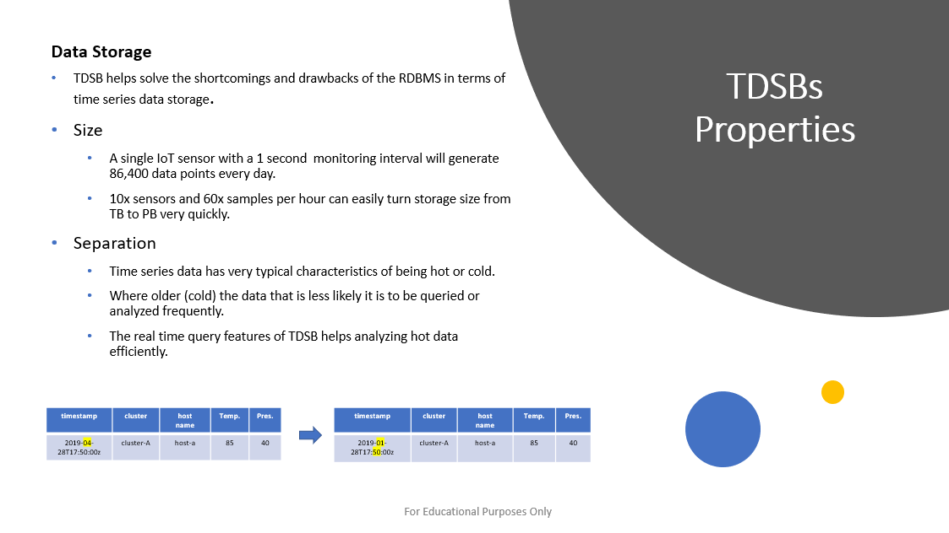

Slide 9
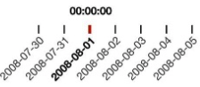
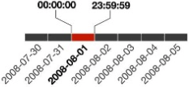
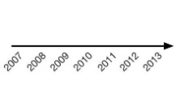
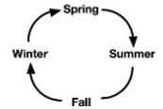
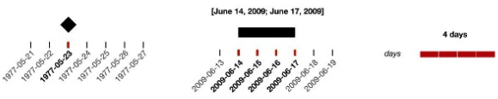
TSDBs Properties
Data granularity
It helps data sets to drill down into small parts where decision making happens at various levels of granularity.
Scope
Point-based vs. Interval-based
Arrangement
Linear vs. Cyclical
Time Primitives
Instant vs. Interval vs. span

Slide 10
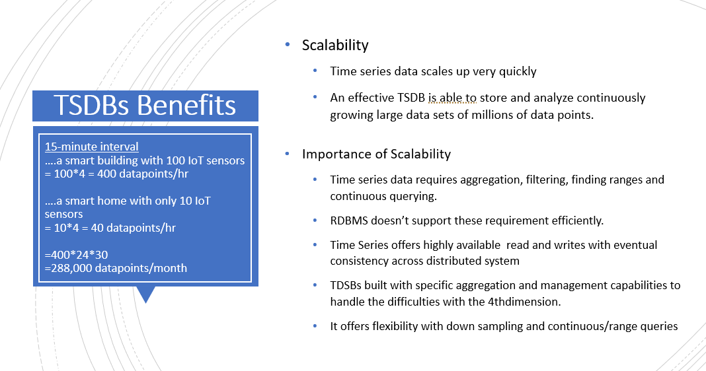

Slide 11
Setting the Stage for Time Series Databases

Slide 12
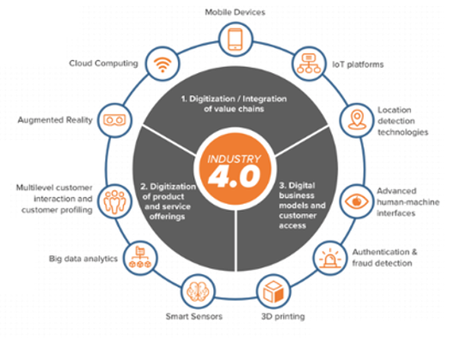
Evolving Industry Landscape
Industrial 4.0
Source: themanufacturer.com

Slide 13

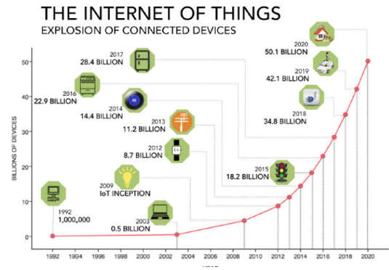
Evolving Industry Landscape
Industrial 4.0
Source: ncta.com
Source: themanufacturer.com

Slide 14
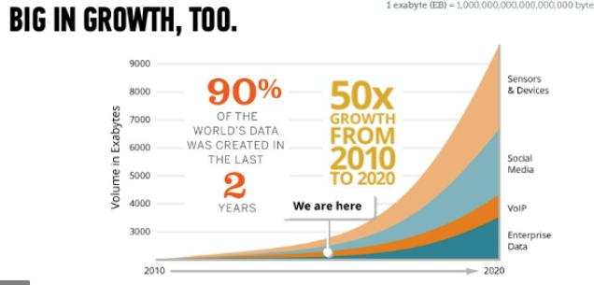
Evolving Industry Landscape
Industrial 4.0
Source: kronosgroup.be
Source: themanufacturer.com

Slide 15
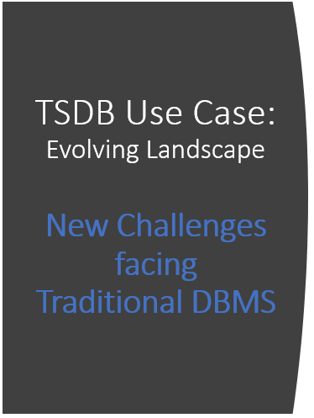
Work with multiple analytics techniques
Handle higher volumes of continuous data flow from multiple sources
Integrate with operation and legacy systems
Store, ingest, integrate and manage time-series data
Manage real-time analytics

Slide 16
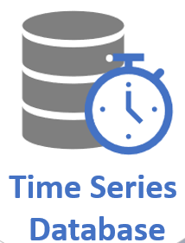
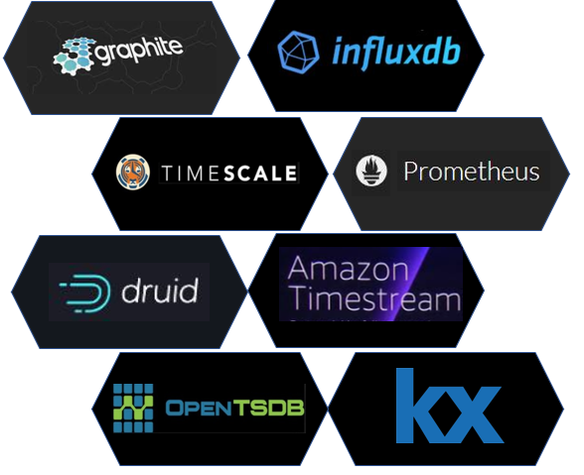
The Solution?

Slide 17
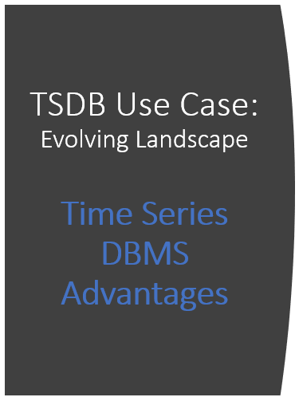
In-Memory Trend Alerts
High capacity
High concurrency for Real-Time Analytics
Fast access for Real-time Analytics, Machine Learning, and AI
In-Memory Value Alerts
In-Memory Data Processing for Applications and Dashboards

Slide 18
Time Series Databases Use Cases

Slide 19
Popular TSDB Use Cases
Infrastructure and Application Performance Monitoring
IoT Platform Monitoring and Analytics
Real-time Analytics & Business Intelligence

Slide 20
TSDB Use Case:
Real-time infrastructure and application monitoring using time series databases helps to identify problems before they negatively impact critical business procedures or begin to cause system failures.
Aims to detect and diagnose complex application performance problems to provide end users with a high-quality experience and to maintain expected levels of service.
Infrastructure
and
Application Monitoring (APM)

Slide 21
TSDB Use Case:
Why monitor your applications’ performance?
Gain early detection of anomalies
Anticipate service disruptions.
Reduce time to remediation and recovery
Optimize user experience
Monitor user traffic to keep experiences consistent
Translates to higher conversion and retention rates
Automate workflows
Use intelligent triggers integrated with auto-remediation to help reduce potential breakpoints
Infrastructure
and
Application Monitoring (APM)

Slide 22
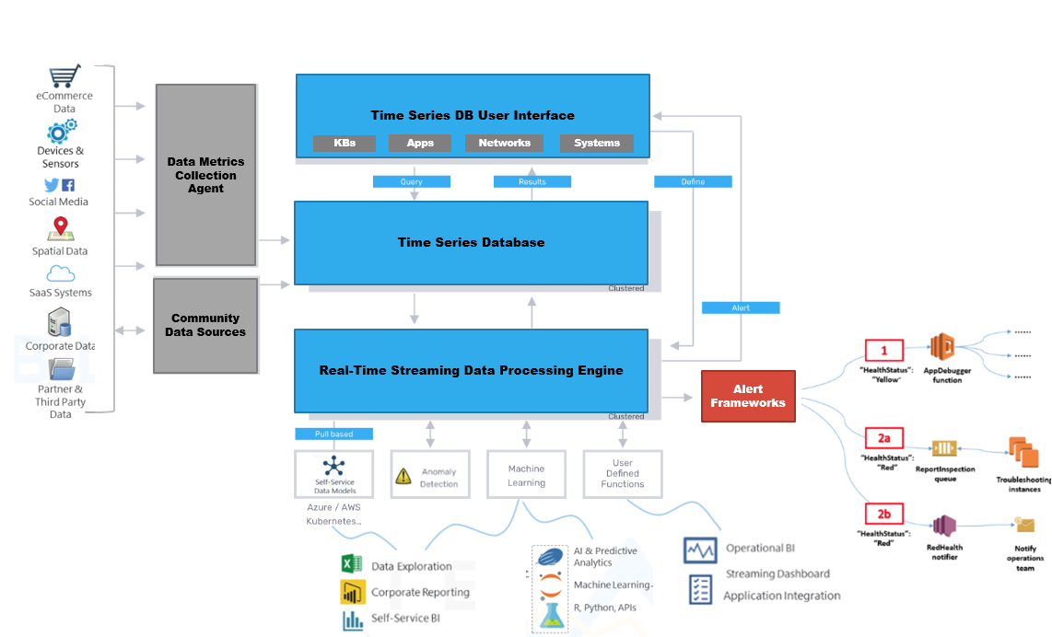

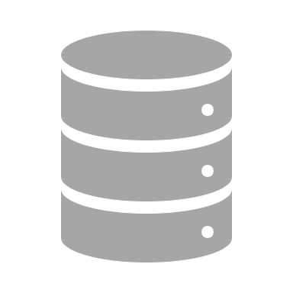
Infrastructure Monitoring Database Platform Architecture
Query
Results
Define
Network devices
Alert
Containers
Pull Based

Slide 23

TSDB Use Case
IoT
Monitoring
and
Analytics
Researchers forecast that there will be over 50 million devices connected by 2020.
IoT enabled platforms ingest billions of events from devices and sensors that span various locals.
Nearly every available surface in the physical world is being instrumented with sensors.
These systems process and analyze streaming data from IoT sensors to derive real-time insights and actions.

Slide 24








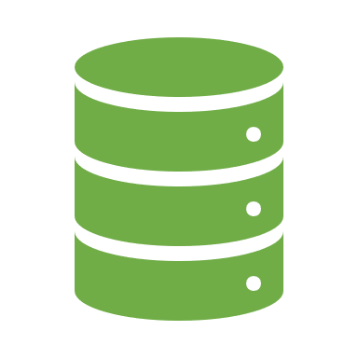
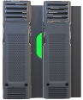

TSDB Use Case
Action Steps for IoT Monitoring Data Processing
visualize
Dashboards
Accumulate
Analyze
Act
notify
Customers
Decision Makers
Iot & Sensors
Collect, normalize, correlate, and aggregate metrics and events from over 100 data sources.
Analyze, store, and manage time series data. Use machine learning libraries for anomaly detection.
Visualize interesting trends, detect events using time series functions, automate your entire system.
automate
Systems
containers
Machine
Learning
IoT
Archive

Slide 25
Database Platform Architecture Diagram IIOT Monitoring
Database Platform Architecture Diagram

Slide 26
IIoT Monitoring Alert Database Platform Architecture

Slide 27

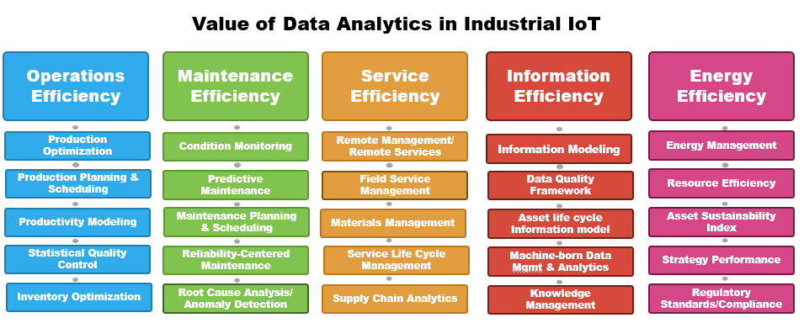
IoT Monitoring and Analytics
Companies are able to deliver business results and improvements to operational efficiency, cost expenditure, and workforce productivity.
Source: Industrial Internet Consortium

Slide 28

TSDB Use Case
Companies that rely on real-time business analytics must be able to …..
Capture, store, and evaluate high frequency time series data using analytic functions such as smoothing, approximation, and interpolation.
Time series databases:
Organizes data by time intervals to help address scalability issues
Improves the speed and performance of queries, aggregation, and analysis of structured data.
Real-time Analytics
and
Business Intelligence

Slide 29
TSDB Use Case
This enables businesses to:
Integrate real time data with advanced analytics to obtain actionable insights that can be used for……..
Improved decision making
Driving greater customer engagement
Improving products and services
Real-time Analytics
and
Business Intelligence

Slide 30
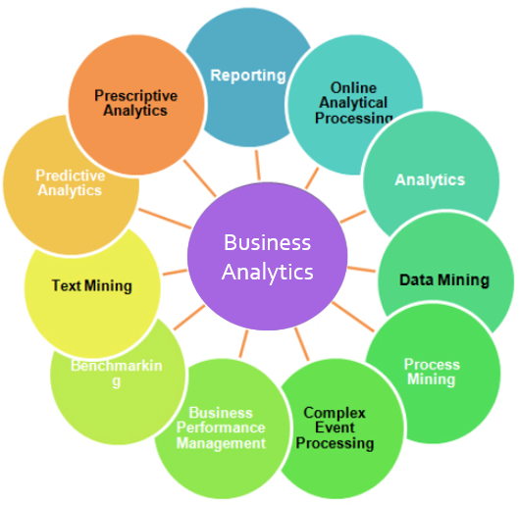
TSDB Use Case
Popular Business Analytics Applications include:
Machine Learning
Predictive Forecasting
Network and Application Optimization
Financial Market Analysis
Real-time Analytics
and
Business Intelligence

Slide 31
Business Data Analytics Database Platform Architecture
Query
Results
Define
Network devices
Alert
Containers
Pull Based

Slide 32
Real World Use Case Example

Slide 33

Real World Use Case Examples
Company Description:
Comcast is the second-largest broadcasting and cable television company in the world by revenue and the largest home Internet service provider in the United States.
Use Case Summary
Leveraged the capabilities unique to TSDB to developed a new strategy for monitoring cloud and container-based environments
Primary Goals:
Remove infrastructure heavy lifting
Consolidate tooling
Provide transparency
Drive efficiencies and identify opportunities
Provide application metrics for developers

Slide 34
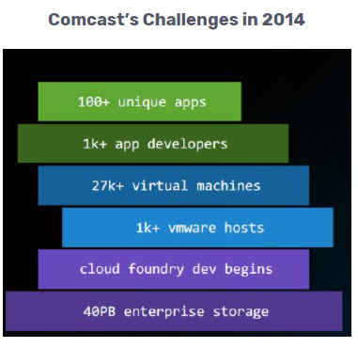
Real World Use Case Examples
The Problem?
Company faced multiple challenges with monitoring and telemetry across modern platforms.
Root-Cause?
Company no longer able to use traditional pull-based monitoring solutions
Platforms maintained ephemeral workloads
Increased growth in time-series event data
Data warehouse silos resulting from legacy systems

Slide 35
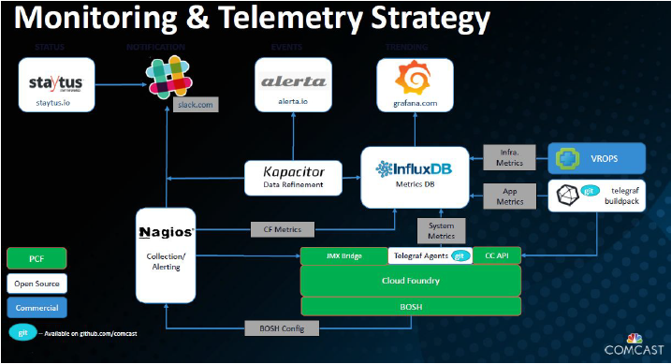
Real World Use Case Examples
The Solution?
Shifted away from the traditional pull approach towards a push approach
Standardized monitoring solutions by consolidating platform infrastructure
Centralized data storage location

Slide 36
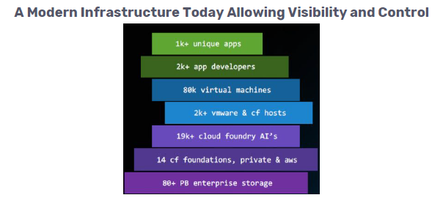
Real World Use Case Examples
Results:
Major transformation on how they manage infrastructure, and how they deliver products
Removed infrastructure heavy lifting
Consolidated tooling
Full transparency throughout the environment
Increased operational efficiency
App metrics are born with new products as they launch

Slide 37
Popular Time Series Databases

Slide 38
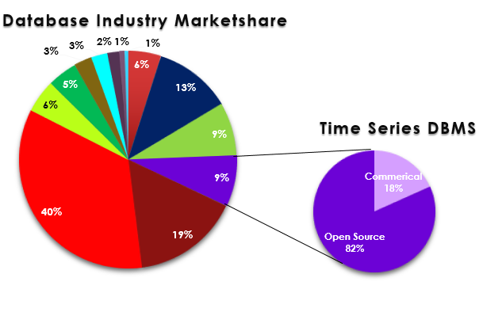
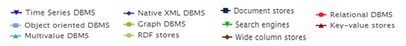
Database Industry Trends
*
Current Industry Demand
8% of today’s publicly available database management systems specialize in time series data analysis.
82% of these systems operate under an open source license.
*source: https://db-engines.com/en/ranking_trend/time+series+dbms

Slide 39
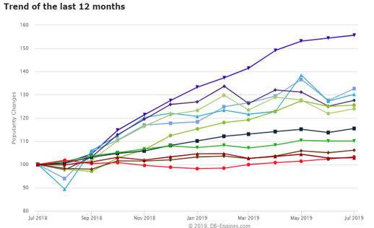
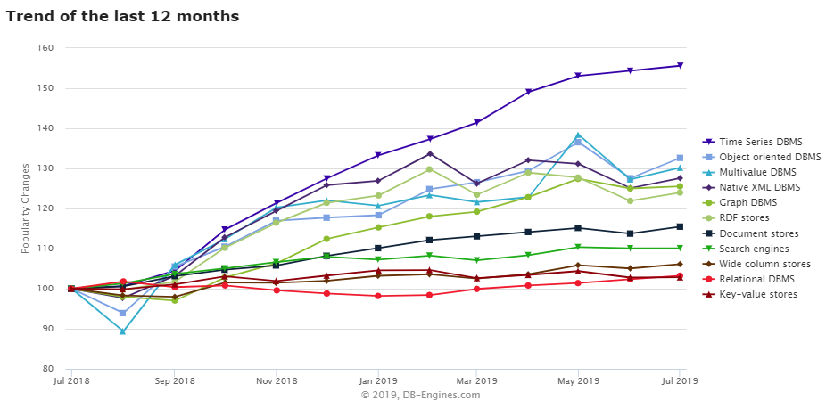
Database Industry Trends
Time Series DBMS have emerged as the fastest growing segment of the database industry over the past year.
Industry Growth over the past 12 months*
Current Industry Demand
*source: https://db-engines.com/en/ranking_trend/time+series+dbms

Slide 40
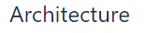
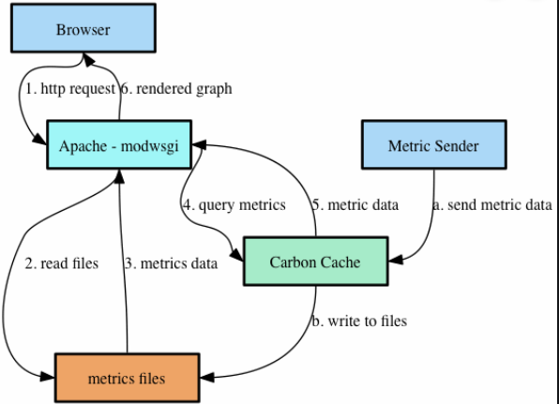

Popular TSDBs
Graphite is a relatively simple TSDB, with a fixed size datastore.
Performance is consistent and reliable over time
Limited capabilities with no multitasking
Graphite has no capabilities for data distribution or replication and is not horizontally scalable.
https://www.aosabook.org/en/graphite.html

Slide 41
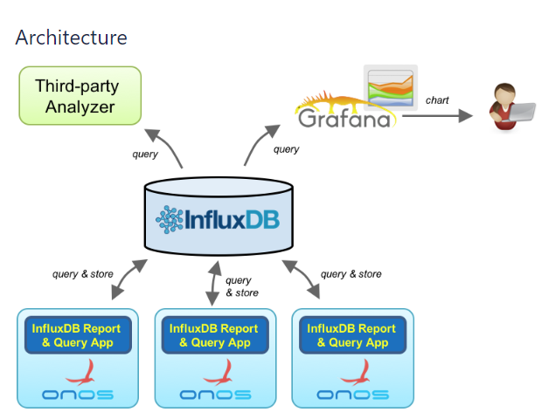

Popular TSDBs
InfluxDB represents one of the most feature complete NoSQL TSDBs, with strong partition tolerance and 100% complete independence.
Designed for high write capacity, distribution, replication, with a feature query processor
Continuous query capabilities make down sampling data user friendly for DBMS
https://www.influxdata.com/

Slide 42
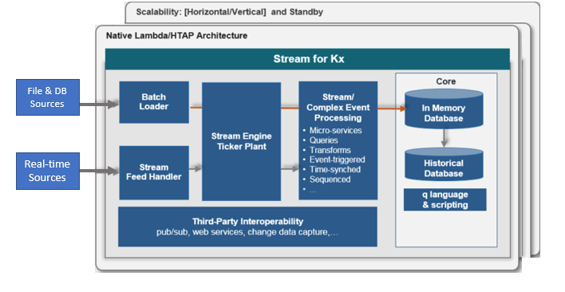

Popular TSDBs
Kx+ is an Integrated columnar DBMS and programming system that provides in-memory capabilities
Provides strong ACID properties
Cumbersome to scale when compared to other NoSQL databases
The only closed-source, commercial solution in our list.
https://kx.com/

Slide 43
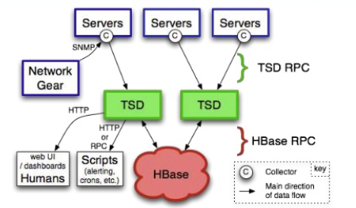
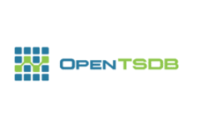
Popular TSDBs
OpenTSDB is a scalable time series database built on top of Hadoop and Hbase that leverages HDFS for much of its distribution and replication capabilities.
Linearly scalable, only accessible through API, and is scalable and performant for write throughput.
http://opentsdb.net/

Slide 44
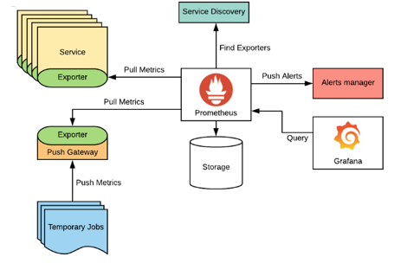

Popular TSDBs
Prometheus is an open-source systems monitoring and alerting toolkit written in Go to enhance for code execution and speed.
Best known for its high dimension data model and system monitoring integration functionality.
Scalability is cumbersome as workloads cannot be automatically distributed without complex configuration.
https://prometheus.io/

Slide 45
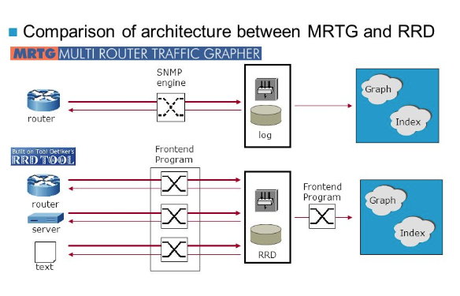
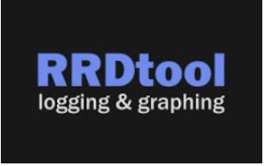
Popular TSDBs
RRDTool was originally designed as a high-performance data logging tool to be integrated into applications.
Another Fixed Database
Size limitations limits its usefulness
https://oss.oetiker.ch/rrdtool/

Slide 46
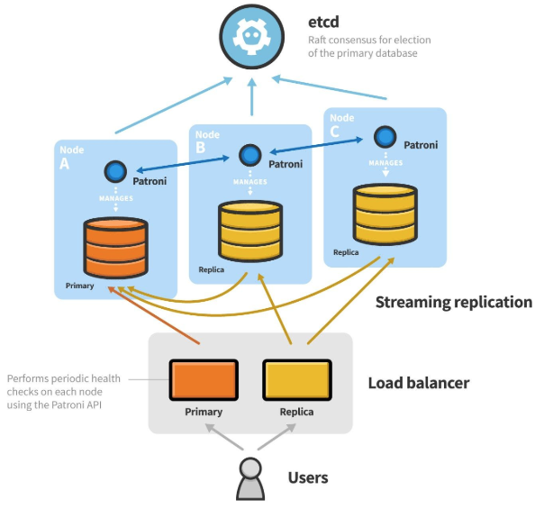
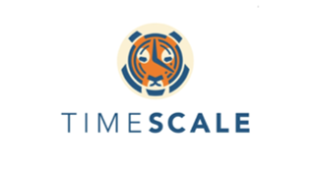
Popular TSDBs
TimescaleDB is a PostgreSQL extension intended to optimize PostgreSQL for time series.
Fully ACID, SQL and JOIN compliant.
Takes its consistency, availability, and partition tolerance model from PostgreSQL
https://www.timescale.com/

Slide 47
Popular TSDBs
TimescaleDB is a PostgreSQL extension intended to optimize PostgreSQL for time series.
Fully ACID, SQL and JOIN compliant.
Takes its consistency, availability, and partition tolerance model from PostgreSQL
https://www.timescale.com/

Slide 48
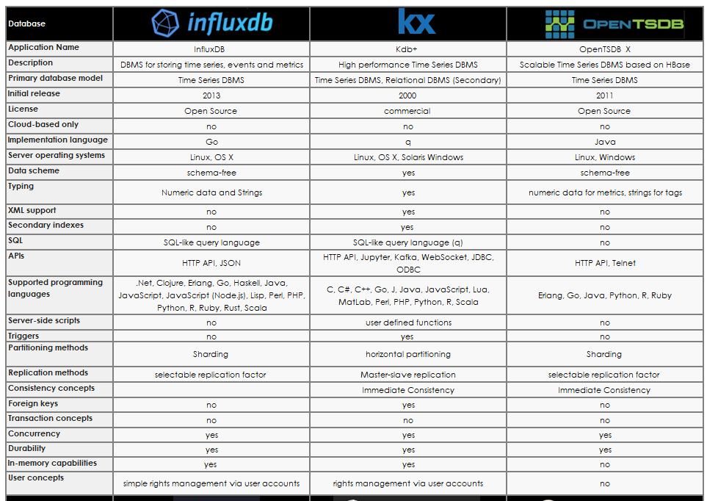
Side by Side Comparison of the Top Leading Providers of Time Series Database Applications
Popular TSDBs
Additional Information

Slide 49
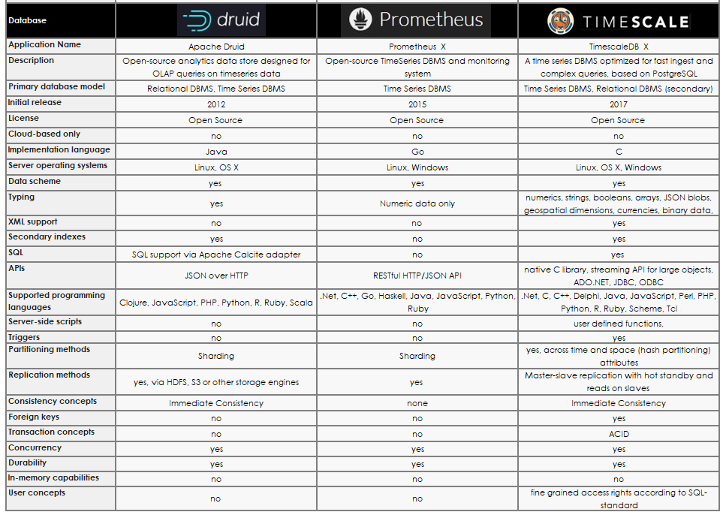
Side by Side Comparison of the Top Leading Providers of Time Series Database Applications
Popular TSDBs
Additional Information

Slide 50
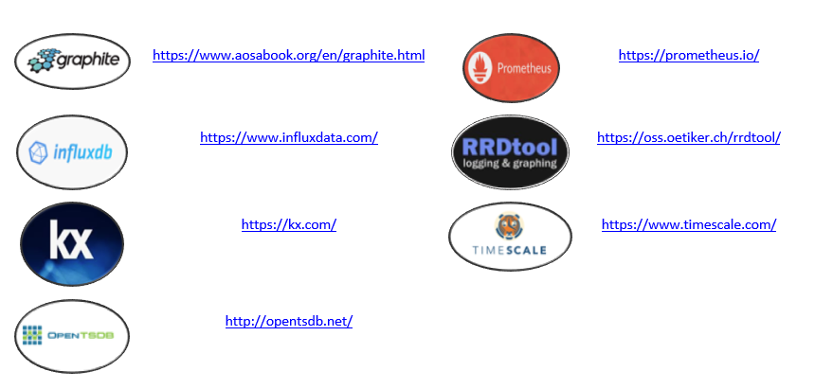
Top Leading Providers of Time Series Database Applications
Popular TSDBs
Please find a list of websites for the time series database applications that were covered throughout this module.
Additional Information
https://www.timescale.com/
https://www.influxdata.com/
https://prometheus.io/
https://kx.com/

Slide 51

Introductions to InfluxDB
An Introduction to Time Series Databases

Slide 52
Agenda
Why InfluxDB?
Installation and Data Import
Using InfluxDB
Line Protocol
Influx Query Language
Managing Retention
Data Management

Slide 53
Why InfluxDB?
Widely deployed in the industry
Financial Sectors
Scientific Sectors
IoT
Excellent performance
Top 3 in all categories
Easiness of use
SQL-like queries
Best overall functionality
Growing Support for OpenSource TICK Stack
Telegraf, InlfuxDB, Chronograph, Kapacitor
Write Performance
Query Speed
Data Compression (Storage)

Slide 54
Installation & Starting InfluxDB on Mac OS
Install Homebrew (if you don’t already have it)
Update Homebrew repo and install InfluxDB
Getting Started
From terminal / cmd, start the service with
Open another window and connect to the shell with
> /usr/bin/ruby -e "$(curl -fsSL https://raw.githubusercontent.com/Homebrew/install/master/install)"
> brew update
> brew install influxdb
> influxd
> influx -precision rfc3339

Slide 55
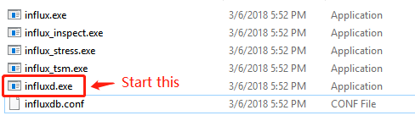
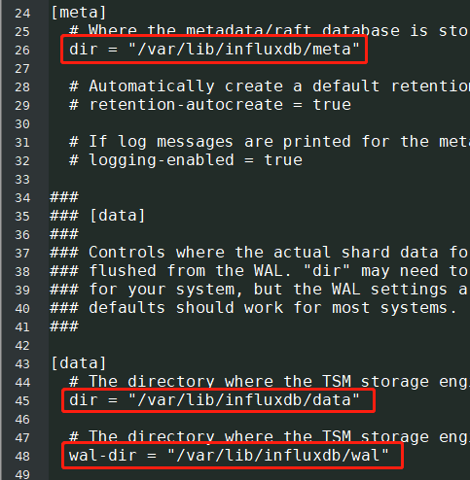
Installation & Starting InfluxDB on Windows
Download and unzip the package from
https://dl.influxdata.com/influxdb/releases/influxdb-1.7.7_windows_amd64.zip
Or find the latest package here: https://portal.influxdata.com/downloads/
unzip influxdb-1.7.7_windows_amd64.zip
Modify 'influxdb.conf’
Only if you need to modify directories
/var/lib equates to C:\Users\<username> on Windows
Start 'influxd.exe'
Start 'influx.exe'

Slide 56
InfluxDb Terminology
Generic RDBMS | InfluxDB
database | database
table | measurement
row | point / series
index | tag (string)
column | field (string | boolean | integer | float)

Slide 57

InfluxDB Line Protocol
The InfluxDB line protocol is a text-based format for importing and writing data to the database. Data must be in line protocol format unless you utilize one of the many translation plugins available. It is expected that the Timestamp is in Unixtime UTC. Without a timestamp data is writing with the servers local timestamp instead.
A single line of text in line protocol format represents one data point in InfluxDB. The measurement is required in line protocol.
+--------------+--------+-+---------+-+----------+ |measurement|,tag_set| |field_set| |timestamp| +--------------+--------+-+---------+-+----------+
Measurement
Tag
Field
Field
Timestamp
Measurement
Tag
Field
Field
Timestamp
Source: https://docs.influxdata.com/influxdb/v1.7/write_protocols/line_protocol_tutorial/

Slide 58
Tutorial Database Creation – NOAA Data
For this tutorial we will utilize water and weather data from the National Oceanic and Atmospheric Administration (NOAA)
We will perform the following steps:
Download the data – this data is preformatted to line protocol
Connect to the Influx database engine
Create a new database called NOAA_water_database
Import data into Influx
Run test queries

Slide 59
Downloading NOAA Data
In a browser go to:
If using curl:
Save the data to a convenient directory
https://s3.amazonaws.com/noaa.water-database/NOAA_data.txt
> curl https://s3.amazonaws.com/noaa.water-database/NOAA_data.txt -o NOAA_data.txt

Slide 60
Connect to InfluxDB
Connect to Influx by typing “influx -precision rfc3339” in a terminal or command prompt. If the command cannot find the executable, use the full path of to the executable to launch.
$ influx -precision rfc3339
Connected to http://localhost:8086 version 1.7.x
InfluxDB shell 1.7.x
>
Note:
The –precision rfc3339 command switch specifies the returned format and precision of returned timestamps for any queries.
In this case we are setting the format and precision to the RFC3339 standard. Example: "2019-08-15T15:52:01+00:00”

Slide 61

Test Connection and Create the NOAA Water Database
Now that we have successful connected to Influx, we can test our connection and create a new database
In the Influx terminal you connected to type:
> CREATE DATABASE NOAA_water_database
Once completed exit by typing:
> exit

Slide 62
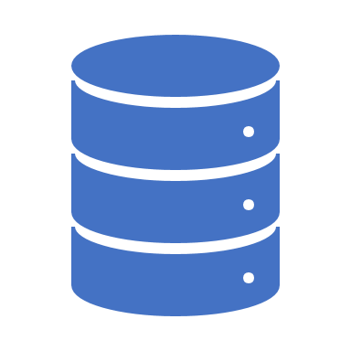
Import NOAA Data In Line Protocal
We can now populate our database. At a command line or terminal prompt, type the following. If necessary, substitute the full path to the data file:
Importing data is rudimentary as long as the file is in line protocol format.
> influx -import -path=NOAA_data.txt -precision=s -database=NOAA_water_database

Slide 63
End to End Database Creation

Slide 64
Using InfluxDb

Slide 65
InfluxDB Query Language Basics
USE [DATABASE]
SHOW DATABASES
SHOW SERIES
SHOW MEASUREMENTS
SHOW RETENTION POLICIES [ON [DATABASE]]
Schema Navigation
SELECT field-key(s),tag-key(s) FROM measurement
SELECT function(field-key) FROM measurement
SELECT [...] WHERE [tag-conditional | field-conditional | time-conditional]
SELECT [...] GROUP BY [tag-key(s) | time-interval]
Influx Query Language
(SQL-like)
CREATE [DATABASE | RETENTION POLICY]
DROP [DATABASE | RETENTION POLICY]
DELETE
DROP MEASUREMENT measurement
DROP SERIES FROM measurement WHERE [tag-conditional | field-conditional | time-conditional]
Data Management
Notes:
There is no concept of update. Insert overwrites an existing row with updated field and tag values.

Slide 66
Begin By Just Looking Around
Execute the following to show the available database, switch to the NOAA_water_database, and show all the available measurements in that database
> show databases
> use NOAA_water_database
> show measurements

Slide 67
Review The Series
Execute the following to show the available series available in the data measurements
> show series

Slide 68
Average Temperature
Lets find the average daily temperature between 9/12/2015 and 9/18/2015 for all locations. This can easily be done with one simple query
> select mean(degrees) from average_temperature where time > '2015-09-12' and time < '2015-09-18' GROUP BY time(1d), location

Slide 69
90th Percentile Temperature
Lets find the 90th percentile temperature between 9/12/2015 and 9/18/2015 for all locations. We will use the same 1d grouping
> select percentile(degrees, 90) from average_temperature where time > '2015-09-12' and time < '2015-09-18' GROUP BY time(1d), location

Slide 70
Influx Query Language
Aggregations | Selectors | Transformations | Technical Analysis | Predictors
COUNT() DISTINCT() INTEGRAL() MEAN() MEDIAN() MODE() SPREAD() STDDEV() SUM() | BOTTOM() FIRST() LAST() MAX() MIN() PERCENTILE() SAMPLE() TOP() | ABS() CEIL() CUMULATIVE_SUM() DERIVATIVE() DIFFERENCE() ELAPSED() EXP() FLOOR() LN() LOG() LOG2() LOG10() MOVING_AVERAGE() NON_NEGATIVE_DERIVATIVE() NON_NEGATIVE_DIFFERENCE() POW() ROUND() SQRT() (Various Trigonometric functions) | CHANDE_MOMENTUM_OSCILLATOR() EXPONENTIAL_MOVING_AVERAGE() DOUBLE_EXPONENTIAL_MOVING_AVERAGE() KAUFMANS_EFFICIENCY_RATIO() KAUFMANS_ADAPTIVE_MOVING_AVERAGE() TRIPLE_EXPONENTIAL_MOVING_AVERAGE() TRIPLE_EXPONENTIAL_DERIVATIVE() RELATIVE_STRENGTH_INDEX() | HOLT_WINTERS()
Source: https://docs.influxdata.com/influxdb/v1.7/query_language/functions/

Slide 71
Managing Data Retention

Slide 72
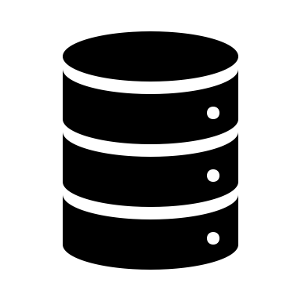
With Time Series Data - Retention Policies Are A Must
When dealing with time series data, you will inevitably reach a point where you cannot retain all the data at full granularity for an indefinite amount of time.
Trade-offs must be made between how long you retain the data, how much data you retain, how granular the data is, and query speed.
Retention Policies ensure that you can down-sample your data (lower the resolution), retain it for a specified duration, and perform regular backups to avoid data loss.
Retention Policies are unique per database, and along with the measurement and tag set they define a series.

Slide 73


Retention Policies – The Expiration Date For Your Data
Retention Policies Describe:
Duration - How long InfluxDB keeps data (default = infinity)
The minimum duration is one hour and the maximum duration is infinity
Replication Factor - How many copies of the data to store in the cluster
Replication factors do not serve a purpose with single node instances.
Shard Group Duration - The time range covered by shard groups
To view the retention policy for the NOAA database type:
> SHOW RETENTION POLICIES ON NOAA_water_database
*autogen is a default retention policy

Slide 74

Retention Policy Operations
CREATE RETENTION POLICY
CREATE RETENTION POLICY <retention_policy_name> ON <database_name> DURATION <duration> REPLICATION <n> [SHARD DURATION <duration>] [DEFAULT]
ALTER RETENTION POLICY
ALTER RETENTION POLICY <retention_policy_name> ON <database_name> DURATION <duration> REPLICATION <n> SHARD DURATION <duration> [DEFAULT]
DROP RETENTION POLICY
DROP RETENTION POLICY <retention_policy_name> ON <database_name>

Slide 75
Altering a Retention Policy
Lets alter our existing retention policy for the NOAA database.
Recall our show retention policy command to view the existing policy
> SHOW RETENTION POLICIES ON NOAA_water_database
Alter the policy to only retain the last 5 years of data
ALTER RETENTION POLICY autogen ON "NOAA_water_database" DURATION 1825d
Exercise extreme caution when modifying retention policies. Retention policy will delete and down sample old data.

Slide 76
Data Management

Slide 77
Data Management Operations
Managing Measurements
Managing Series
Removing Databases
Performing Backups
X

Slide 78
Managing Series and Measurements
As we have discussed, adding measurements or series is as simple as writing a new measurement, in line protocol, to the database
However, at times, you may want to remove specific series or entire measurements from the database. This is easily done with a DROP statement.
DROP MEASUREMENT measurement
DROP SERIES FROM measurement WHERE [tag-conditional | field-conditional | time-conditional

Slide 79
Drop Series and Measurements
Lets drop the Coyote Creek location series from average_temperature measurement
Lets also drop the entire h2o_temperature measurement
> drop series from "average_temperature" where "location" = 'coyote_creek'
> drop measurement "h2o_temperature"

Slide 80
Performing Backups
Mac: > influxd backup -portable -database NOAA_water_database /tmp/backup/longterm
Windows: C:\<file path>\influxdb.exe backup -portable -database NOAA_water_database C:\tmp\backup\longterm

Slide 81
Deleting An Entire Database
The DROP DATABASE query deletes all of the data, measurements, series, and retention policies from the specified database.
> drop database NOAA_water_database
Do not perform this procedure unless you are completely done with this tutorial and are ready to remove all NOAA test data

Slide 82
InfluxDB - Time Series Database
Conclusion

Slide 83
Tutorial Conclusion
We have reviewed a practical example of timeseries in the InfluxDB Time Series Database
Installation
Terminology for Time Series
Data Import Procedure
Data Manipulation
Data Management
Database Management

